Slide 1
Unmanned Aerial Vehicle (UAV)
NAME: MUHAMMAD ZULHAFIZ BIN ZULKIFLI
MATRIC NO: 1812661

Slide 2
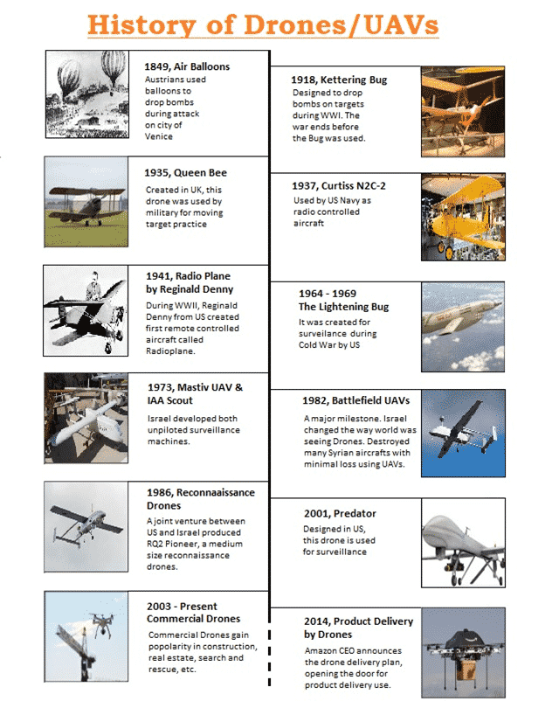
History
The Unmanned Aerial Vehicles have been around us for centuries. The idea of drones was first conceived for the use by Military during war. The first documented use of a Drone/ UAV is of 1849 when Austrians attacked the city of Venice using unmanned Air Balloons loaded with explosives. Then in 1915, they were used by British military to take aerial photographs of German movements in the are during Battle of Neuve Chapelle.
Later, United States came with ‘Kettering Bug’ in 1918 that was designed to drop bombs on targets. Then came Queen Bee and Curtiss N2C-2 in thirties, which were better than its predecessors. In 1941 during WW II, Reginald Denny from US made the first radio controlled aircraft called Radioplane OQ-2. It was the first drone to be mass produced ever. Further, in 1964, US created the Lightening Bug for secret surveillance during cold war. In 1973, Israel made a game changer entry in drone field with Mastiv UAV and IAA scout.

Slide 3
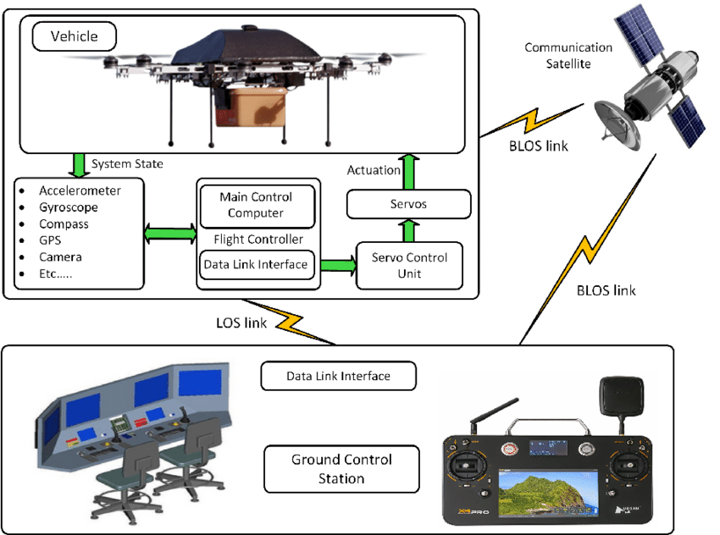
System Architecture

Slide 4
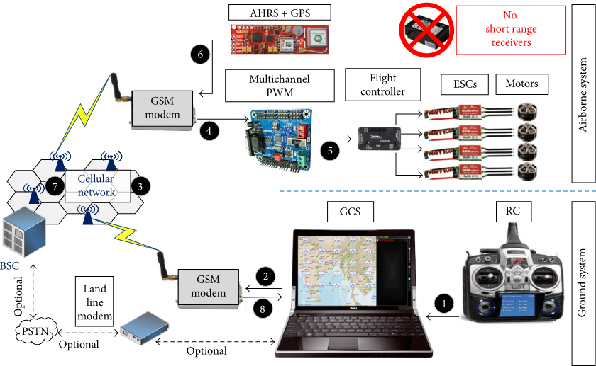
System Architecture

Slide 5
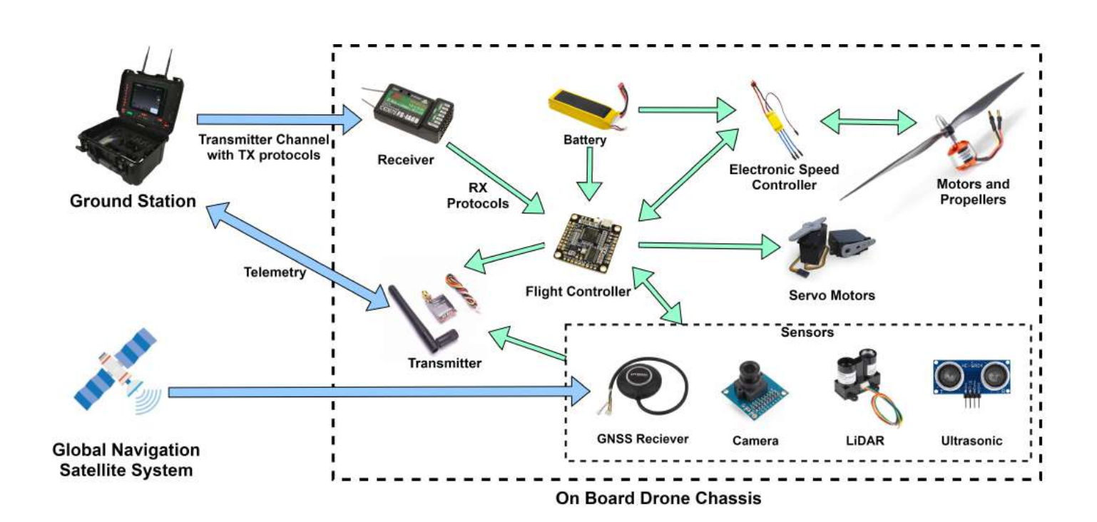
System Architecture

Slide 6
Robotics Hardware Components
Robot Design
Actuators & Locomotions
Navigation & Controller
Data Collection
Data Transmission
Power System Management

Slide 7
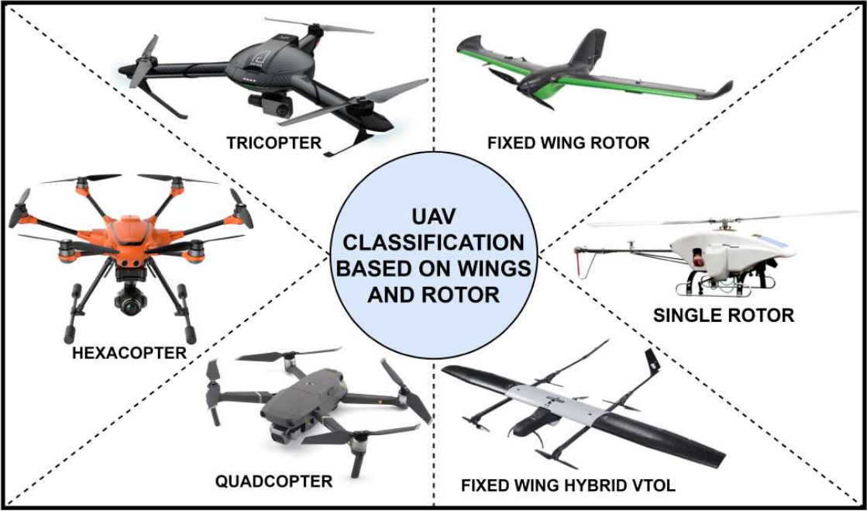
Robot Design

Slide 8
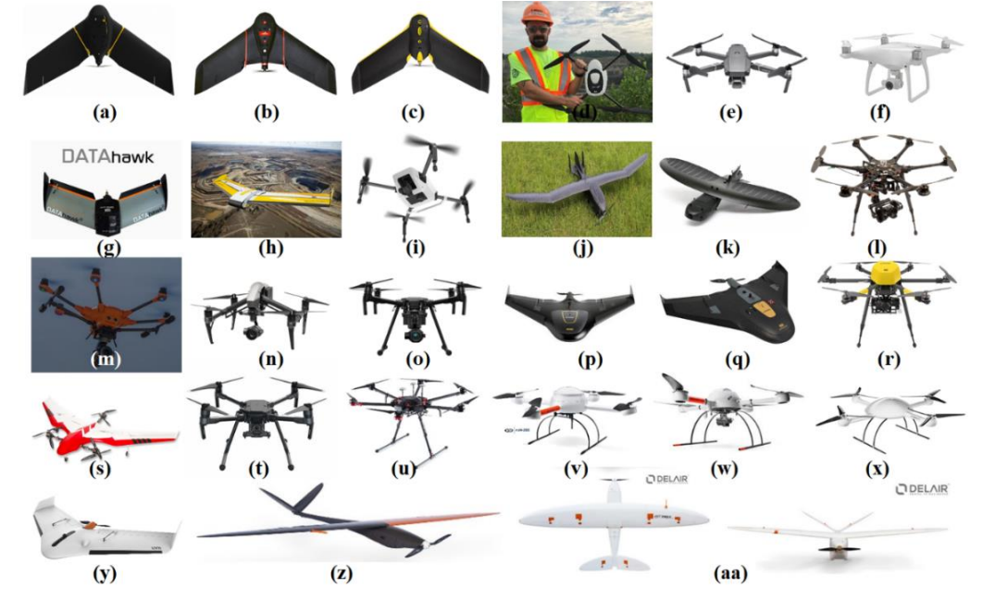
Robot Design

Slide 9
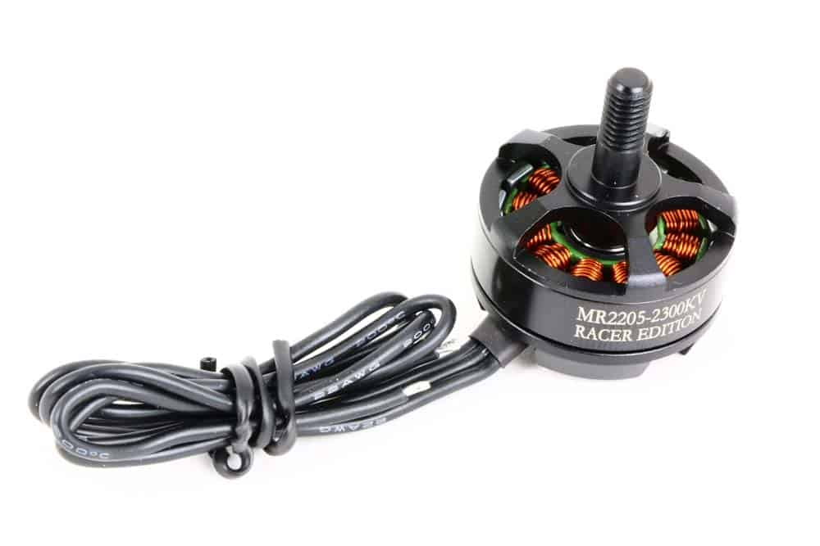
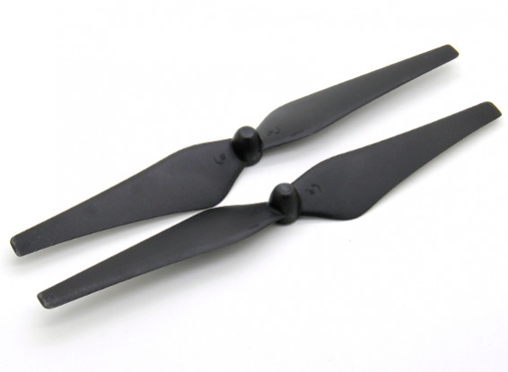
2. Actuators & Locomotions
Motors
Propellers
1. Provide lift for the aircraft by spinning and creating an airflow, which results in a pressure difference between the top and bottom surfaces of the propeller.
2. Propeller speeds are varied by changing the voltage supplied to the propeller’s motor.
3. Drone propellers can be constructed with two, three, or four blades.
4. Propellers with more blades provide greater lift due to more surface area moving through the air per rotation, but are more inefficient due to increased drag.
5. Drone propeller blades are most commonly constructed from plastic or carbon fiber.

Slide 10
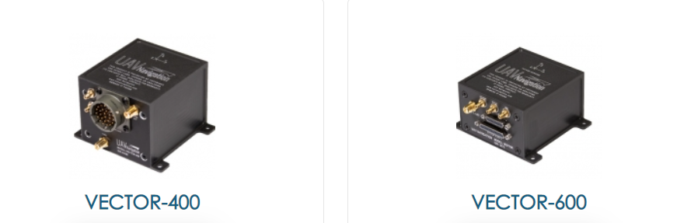
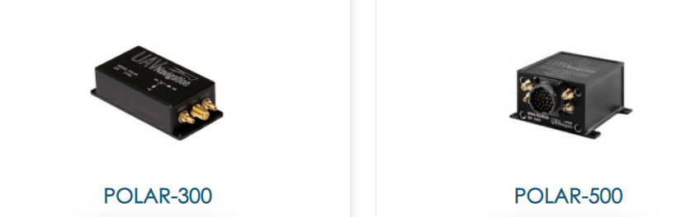
3. Navigation & Controller
Autopilots - UAV Navigation advanced autopilots for controlling fixed wing, helicopter and target drone platforms.
AHRS/IMU - Flight control algorithms and to fuse the data provided by multiple sensors.

Slide 11
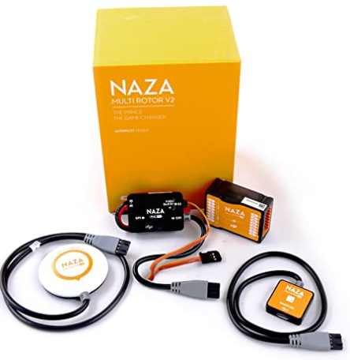
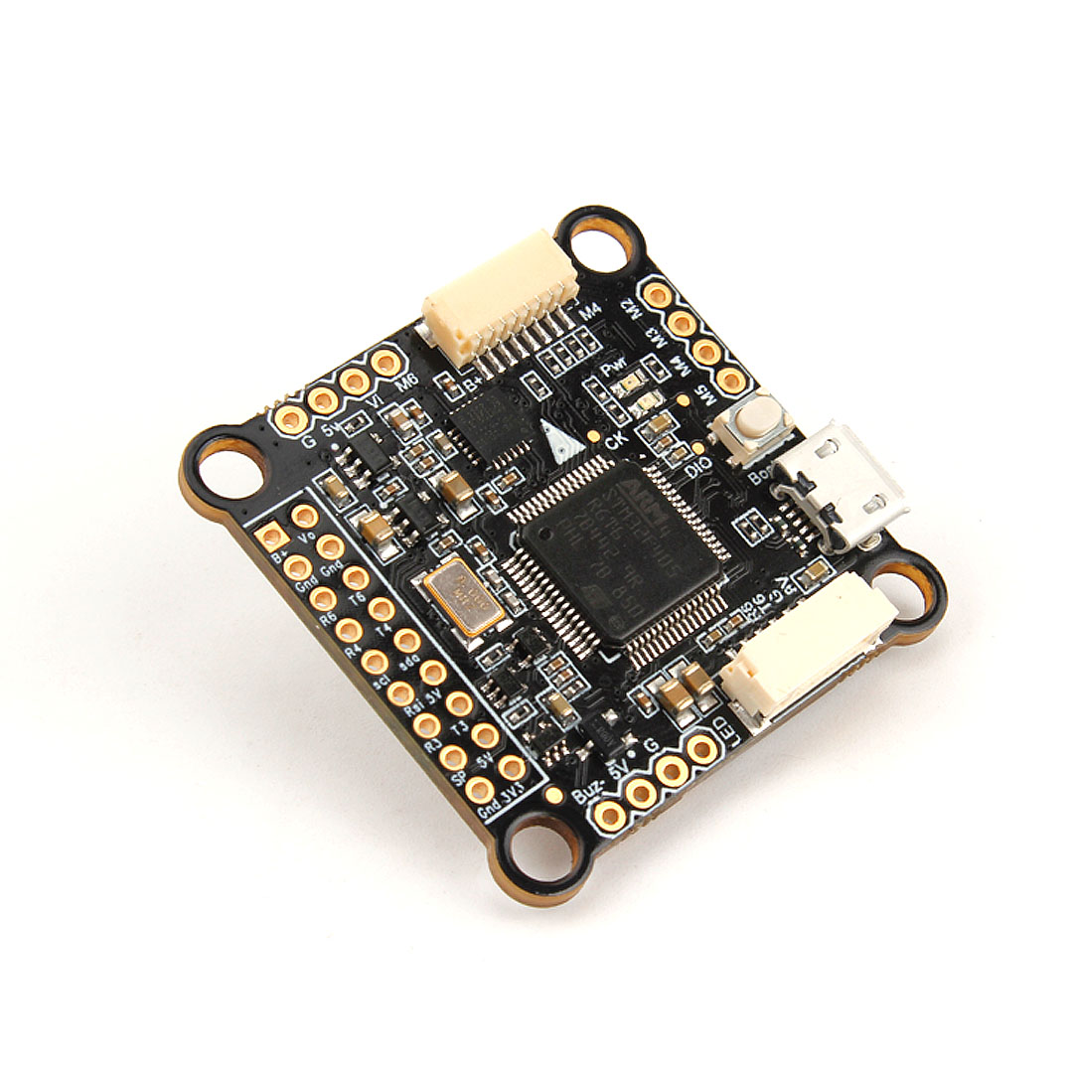
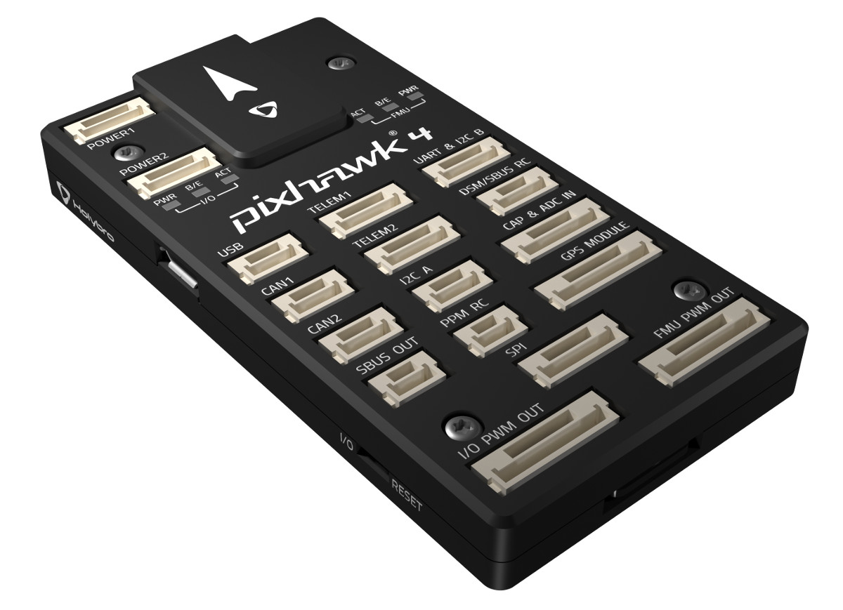
3. Navigation & Controller
The flight controller uses the data gathered by the sensors to calculate the desired speed for each of the drone motors.
DJI Naza-M V2 Flight Controller V2
Pixhawk PX4 Flight Controller 32 Bit Flight Control Board
Holybro Kakute F4 V2.3 Flight Controller

Slide 12
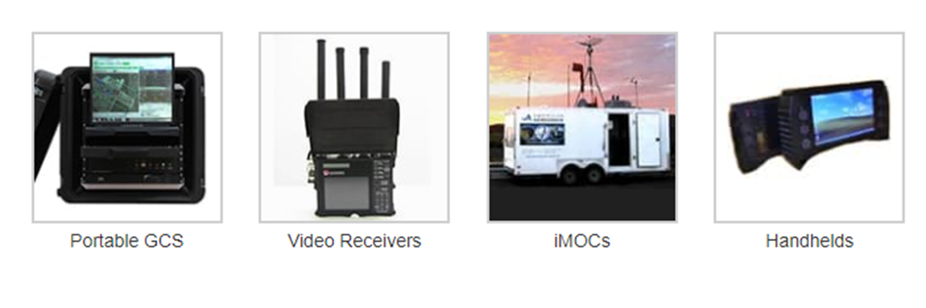
3. Navigation & Controller
1. GCS is responsible for controlling unmanned vehicles and payloads.
2. Installed application allows easy configuration of UAV.
3. Monitor measurement and sensing equipment.
4. Handheld controller is robust and can be used in harsh environment.

Slide 13
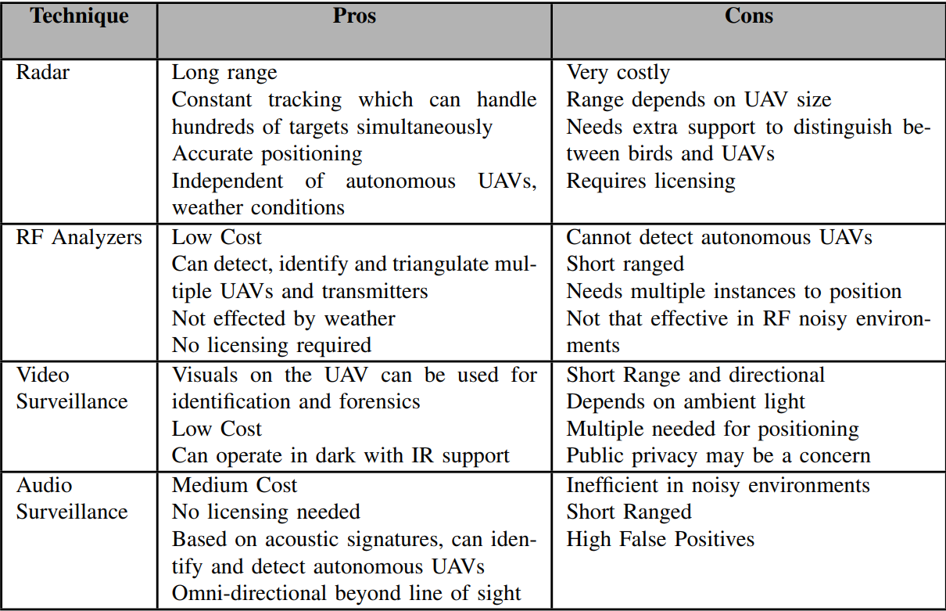
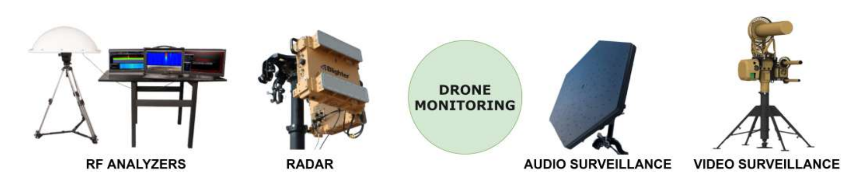
4. Data Collection

Slide 14
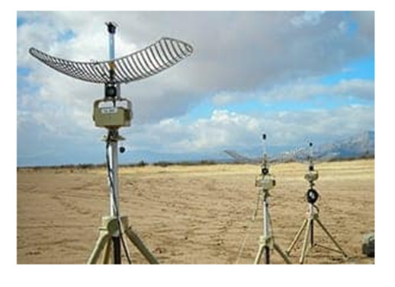
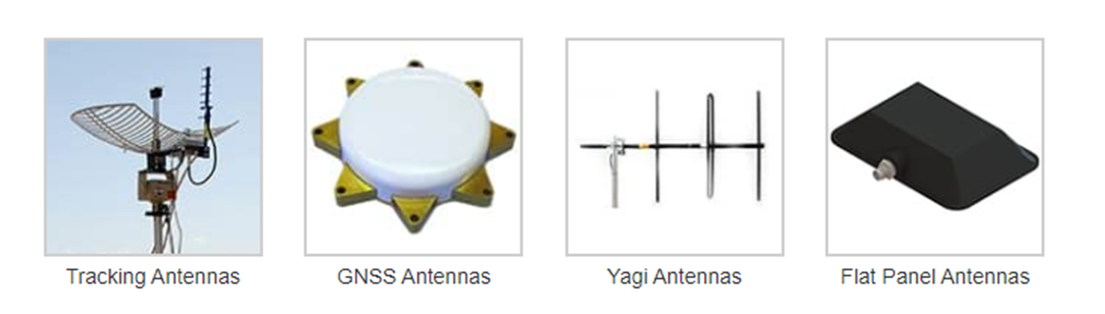
5. Data Transmission
1. Antennas are used for data recording and transmission and avionic functions.
2. Allow information transmission to other systems and people on ground.
3. Ground-to-ground, Ground-to-air, air-to-ground.

Slide 15
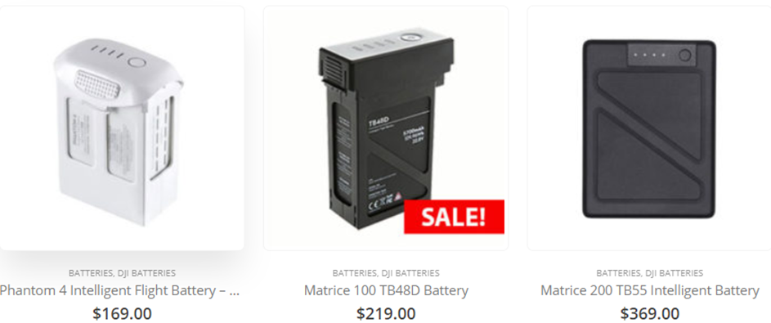
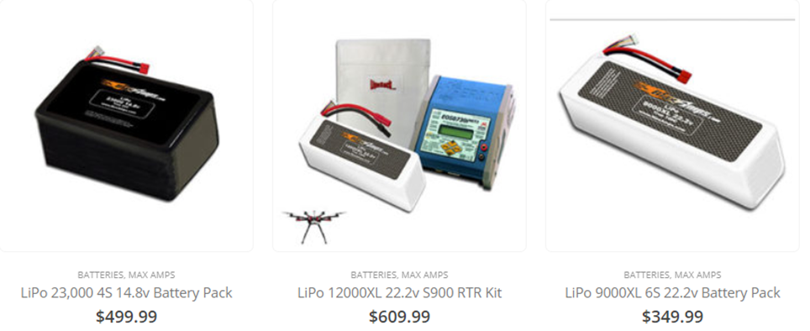
6. Power System Management

Slide 16





UAV Companies in Malaysia
DEFTECH: https://www.deftechust.com/
Malayisia UAV Developments Association: https://muda.org.my/
Poladrone: https://poladrone.com/
Kambyan Network: https://www.kambyan.net/
Vortex Edge Sdn Bhd: http://www.vortex-edge.com/uav-solutions/

